Slide 1
MongoDB Development in Python

Slide 2
Contents
PyMongo essentials
CRUD operations
Demo folder: 04-MongoDB-Python

Slide 3
1. PyMongo Essentials
Overview
PyMongo API documentation
Connecting to a MongoDB instance
Getting a handle to a database
Getting a collection
MongoDB documents in Python

Slide 4
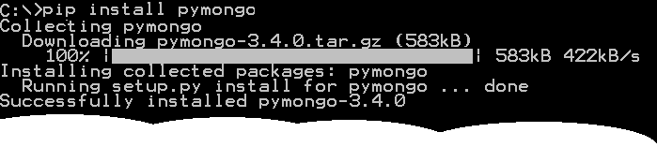
Overview
You can use Python to access MongoDB databases
Via the PyMongo Python package
You can install PyMongo as follows in Windows:
All being well, you should see the following messages:
pip install pymongo

Slide 5
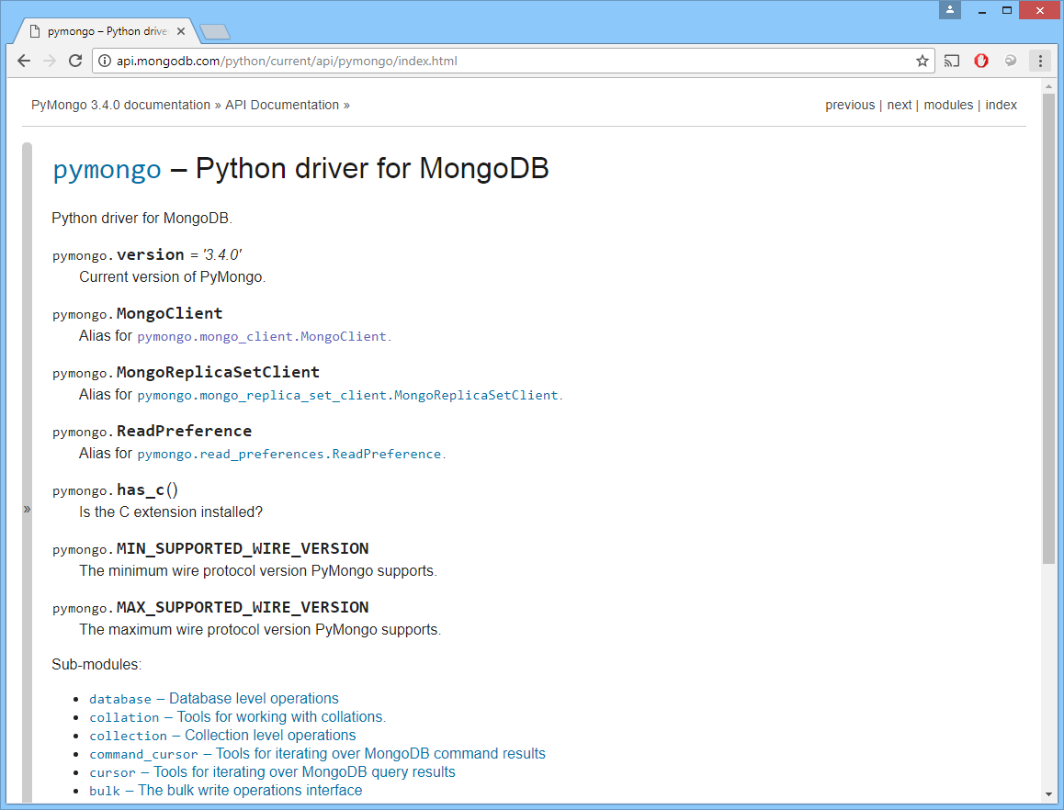
PyMongo API Documentation
The PyMongo API is similar to the MongoDB JS API
Generally you just convert method name capitals to _
See http://api.mongodb.com/python/current/api/pymongo

Slide 6
Connecting to a MongoDB Instance
Assume you already have a MongoDB instance running
E.g. by running mongod.exe, as discussed in earlier chapters
You can connect to the MongoDB instance in Python
Via the MongoClient class
from pymongo import MongoClient
# Connect to MongoDB instance on the default host and port.
client1 = MongoClient()
# Or connect to a specific host, port.
client2 = MongoClient('localhost', 27017)
# Or connect via a URL.
client3 = MongoClient('mongodb://localhost:27017/')
connect.py

Slide 7
Getting a Handle to a Database
A MongoDB instance can support multiple databases
E.g. different databases for different sets of data
The MongoClient class allows you to access the databases on a MongoDB instance
from pymongo import MongoClient
client = MongoClient()
# Get a list of all the database names.
dbNames = client.database_names()
print("Database names: %s" % dbNames)
# Get the "test" database, using attribute-style syntax.
testDb1 = client.test
print("testDb1: %s" % testDb1)
# Get the "test" database, using dictionary-style syntax.
testDb2 = client['test']
print("testDb2: %s" % testDb2)
getDatabases.py

Slide 8
Getting a Collection
You can get a collection in the database as follows:
from pymongo import MongoClient
client = MongoClient()
db = client.test
# Get the "people" collection, using attribute-style syntax.
people1 = db.people
print("people1: %s" % people1)
# Get the "people" collection, using dictionary-style syntax.
people2 = db['people']
print("people2: %s" % people2)
getCollections.py

Slide 9
MongoDB Documents in Python
In Python, a MongoDB document is represented as a dictionary
The dictionary contains name/value pairs
Correspond to fieldnames/values in a MongoDB document
# Create and initialize a Python dictionary object.
person1 = {
"name": "Jayne",
"age": 52,
"gender": "F",
"langs": ["English", "French"]
}
# Create an empty Python dictionary first, and then add fields via [].
person2 = {}
person2["name"] = "Andy"
person2["age"] = 52
person2["gender"] = "F"
person2["langs"] = ["English", "French", "Norwegian"]

Slide 10
2. CRUD Operations
Creating documents
Reading documents
Updating documents
Deleting documents

Slide 11
Creating Documents
To create documents in a collection, call:
insert_one()
insert_many()
from pymongo import MongoClient
client = MongoClient()
db = client.test
people = db.people
people.insert_one(
{ "name": "Jayne", "age": 52, "gender": "F" }
)
people.insert_many([
{ "name": "Thomas", "age": 20, "gender": "M" },
{ "name": "Emily", "age": 20, "gender": "F", "favTeam": "Swans" }
])
createDocuments.py

Slide 12
Reading Documents
To read documents in a collection, call:
find()
find_one()
from pymongo import MongoClient
import pprint
# main code
client = MongoClient()
db = client.test
people = db.people
allPersons = people.find()
printItems("All persons", allPersons) # Helper function
person1 = people.find_one({"name": "Andy"})
pprint.pprint(person1)
somePersons = people.find({
"name": {"$regex": "^J" },
"gender": "F",
"$or": [
{ "age": { "$lt": 20 } },
{ "age": { "$gt": 30 } }
]
})
printItems("All persons", allPersons) # Helper function
readDocuments.py

Slide 13
Updating Documents (1 of 2)
To update documents in a collection, call:
update_one()
update_many()
replace_one()
These methods are similar to the JavaScript API, except the parameters are slightly different. For details, see:
http://api.mongodb.com/python/current/api/pymongo/collection.html

Slide 14
Updating Documents (2 of 2)
Example
from pymongo import MongoClient
import pprint
# main code
client = MongoClient()
db = client.test
people = db.people
people.update_one(
{ "name": "Jayne" },
{ "$set": { "name": "JAYNE", "favTeam": "Swans" } }
)
people.update_many(
{},
{ "$inc": { "age": 1 } }
)
people.update_many(
{},
{ "$rename": { "favTeam": "favouriteTeam" } }
)
printItems("People", people.find()) # Helper function
updateDocuments.py

Slide 15
Deleting Documents (1 of 2)
To delete documents in a collection, call:
delete_one()
delete_many()
These methods are similar to the JavaScript API, except the parameters are slightly different. For details, see:
http://api.mongodb.com/python/current/api/pymongo/collection.html

Slide 16
Deleting Documents (2 of 2)
Example
from pymongo import MongoClient
import pprint
# main code
client = MongoClient()
db = client.test
people = db.people
people.delete_one(
{ "name": "Wilfried" }
)
people.delete_many(
{ "favouriteTeam": "Cardiff" }
)
people.delete_many(
{ "overdraft": { "$exists": True } }
)
printItems("People", people.find()) # Helper function
deleteDocuments.py

Slide 17
Any Questions?

